Slide 1
Investigations

Slide 2
Linked IG Functions
INSPECTIONS
TEACHING
AND
TRAINING
ASSISTANCE
INVESTIGATIONS

Slide 3
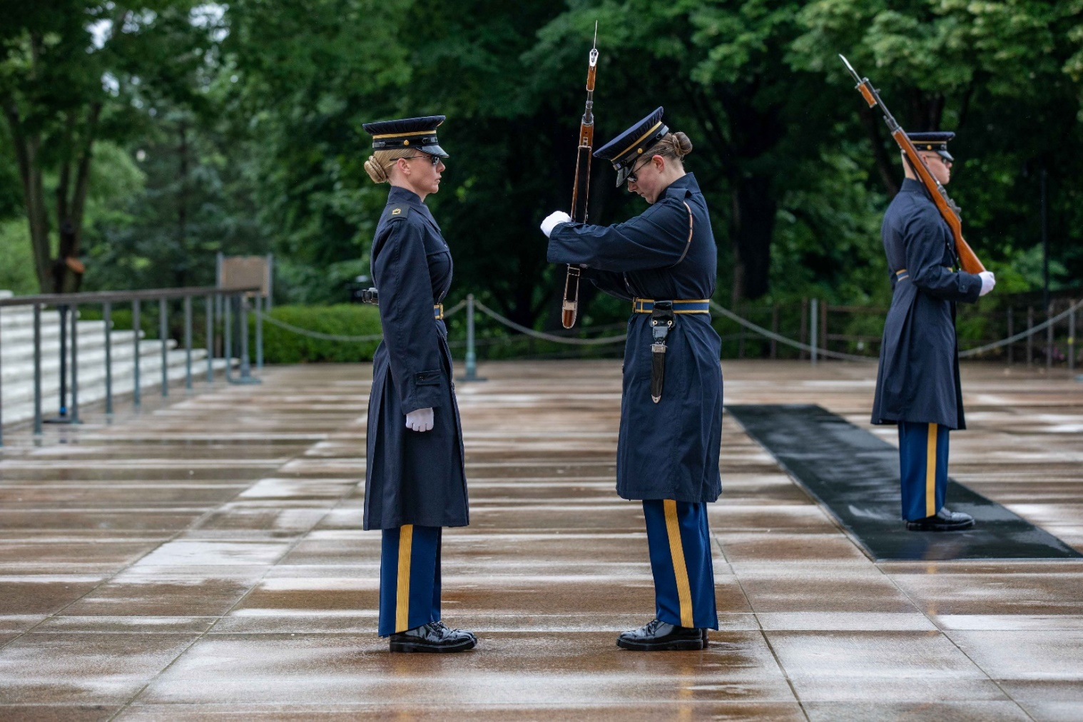
What Do We See Here?

Slide 4
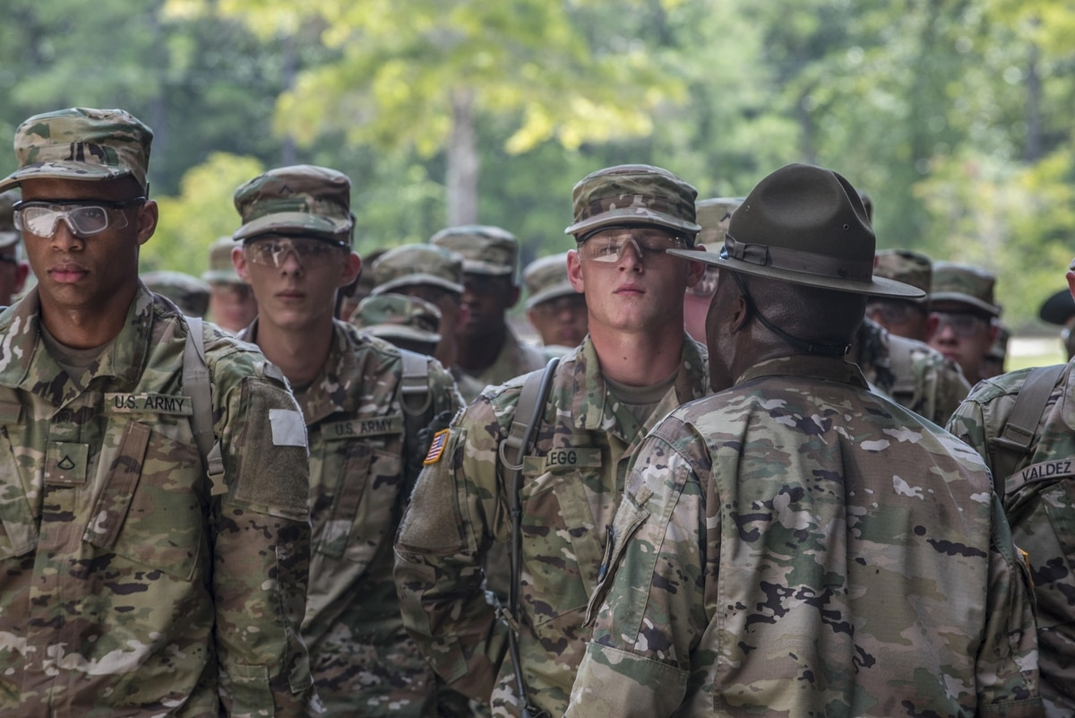
What About Here?

Slide 5
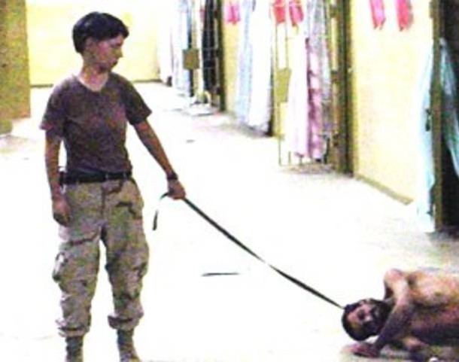
…And Here?

Slide 6

Could This Be You?

Slide 7
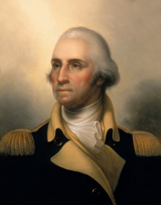
IG Investigator’s Purpose?
BLUF: Resolve Allegations of Impropriety
...using a Report of Investigation (ROI)
APPROACH:
    Unwavering commitment to standards
    Focus on Army Values
    Protect the best interests of the Army
LIMITATIONS:
    IGs work for the Directing Authority!
    One investigatory option
    DO NOT seek out allegations

Slide 8

References
  AR 20-1, IG Activities and Procedures Chapters 1, 3 and 7, Appendix A, B, D, E and the Glossary
  The Assistance and Investigations Guide Part Two & Part Three (and some of Part One)
  Advance Sheets & Course Material
  Please have these resources available every class!
AR 20-1 / Other Source Information Reference; The A&I Guide, Source Information Reference

Slide 9
Investigations
Training Schedule
Day 8 (Wednesday)
0900-1200 Intro; definitions; IGAP 1 & 2
1300-1630 IGPA; form allegations; Action Memo & Directive; Plan; IGAP 3-4; PEs 1-7 (Student Script Readers)
1630-1700 Suspect Notification (Telephonic)
Day 9 (Thursday)
0800-1030 Gather & analyze evidence; 4-Part Interview; IGAP 4; PE's 8-10 (Student Script Readers)
1030-1200 Witness telephone interview prep
1300-1350 Live Witness telephone interview; PE 11
1400-1450 DA 3881 / Lawyers
1500-1630 Suspect interview prep; PE 12
1630-1700 Conduct Suspect Lawyer Phone Call

Slide 10
Investigations
Training Schedule
Day 10 (Friday)
0800-0900 Live Suspect interview & AAR; PE 13
0900-1100 Graded Homework PE 14; introduce ROI
Writing an ROI; final notifications; follow-up; close IGAR; finish IGAP 4; IGAP 5-7
** Special IG Investigations**
1100-1500 Whistleblower Reprisal investigations
1500-1600 DoD Hotline Case Processing
Day 11 (Monday)
0800 INVESTIGATIONS HOMEWORK DUE
0800-0900 INVESTIGATIONS QUIZ & Post-Quiz review

Slide 11
Terminal Learning Objective
Action: Resolve allegations of impropriety.
Conditions: Given Army Regulation 20-1, The Assistance and Investigations Guide, Army Regulation 600-20, handouts, classroom instruction, and allegations of impropriety.
Standard: Apply the seven-step Inspector General Action Process (IGAP) to resolve an allegation of impropriety, culminating in a Report of Investigation (ROI) that accurately substantiates or does not substantiate the allegation. In addition, describe special situations with regard to Inspector General Investigations.

Slide 12
Enabling Learning
Objectives
Advance Sheets pages 21 - 22
ELOs
Knowledge-based ELOs:
1. Describe a person's role and status in an Inspector General (IG) Investigation / Investigative Inquiry.
2. Describe an individual’s rights or non-rights given that person’s role and status.
3. Describe a fact and the levels of evidence used in the Investigations function.
Describe the IG Standard of proof.
Describe the parts of an allegation.

Slide 13
Enabling Learning
Objectives
ELOs
Knowledge-based ELOs (cont.):
6. Describe an IG Investigation and an IG Investigative Inquiry and the differences between them.
7. Describe the procedures for referring allegations of impropriety to the command.
8. Describe how an IG plans an Investigative Inquiry or Investigation.

Slide 14
Enabling Learning
Objectives
ELOs
Knowledge-based ELOs (cont.):
9. Describe a request for IG information and the proper actions taken by the IG.
Application-based ELOs (cont.):
10. Determine if an allegation received by the IG is appropriate for IG action.
11. Explain which IG method – Investigative Inquiry or Investigation – is preferable for a particular case.

Slide 15
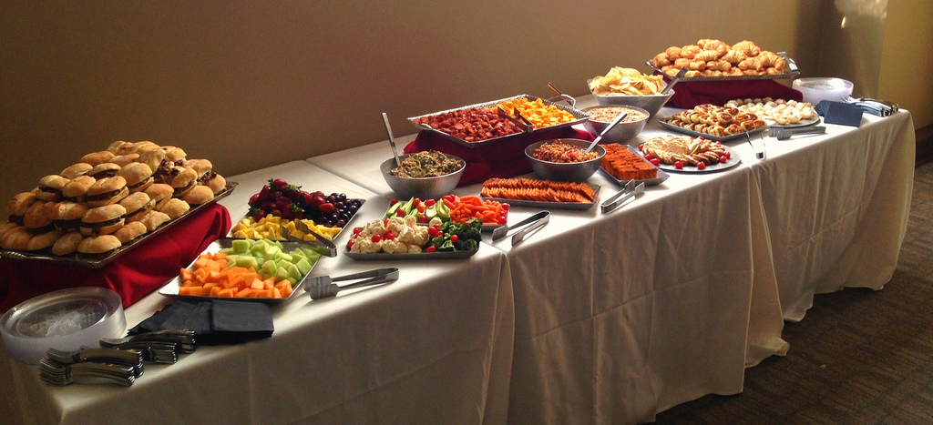
Enabling Learning
Objectives
ELOs
Application-based ELOs (cont.):
12. Demonstrate evidence-gathering activities by reviewing documents; analyzing data; and interviewing witnesses, subjects, or suspects.
13. Complete a Report of Investigation (ROI).

Slide 16
Safety and Environmental
Safety Requirements: No other specific safety requirements are unique to this block of instruction per DA PAM 385-30, Risk Management, dated 2 December 2014.
Risk Assessment Level: Low in accordance with TRADOC Regulation 385-2, U.S. Army Training and Doctrine Command Safety and Occupational Health Program, dated 9 January 2019.
Environmental Considerations: None in accordance with AR 200-1, Environmental Protection and Enhancement, dated 13 December 2007, and ATP 3-34.5, Environmental Considerations, dated 10 August 2015.

Slide 17
Person's Role and Status
DEFINITIONS
ELO 1
Complainant: Anonymous, Injured Party, Third Party
Role: Witness, Subject, Suspect
Status: Military, DA Civilian, Contract Civilian,
or Civilian-Civilian
Subject / Suspect: Unit? Status? At the time in question
Commander / Supervisor

Slide 18
Roles
DEFINITIONS
ELO 1
Witness:
  Someone who we believe has some knowledge to support or to refute an allegation (may be a subject-matter expert (SME))
Subject:
  Someone against whom a non-punitive allegation is made
Suspect:
  Someone against whom a punitive* allegation is made
  *Violations of law (UCMJ & USC) are punitive offenses.
The A&I Guide, Part Two, Section 1-3 (II-1-9) /Digital Page 195

Slide 19
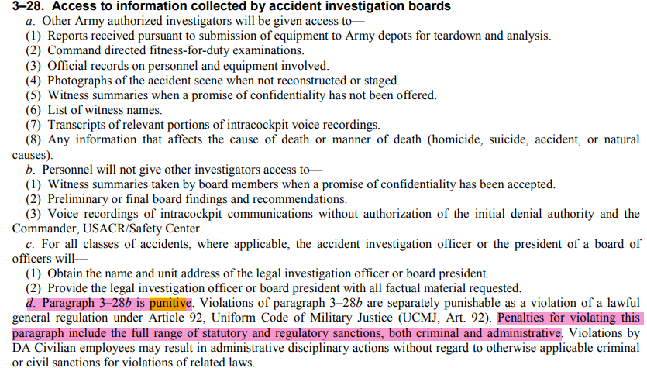
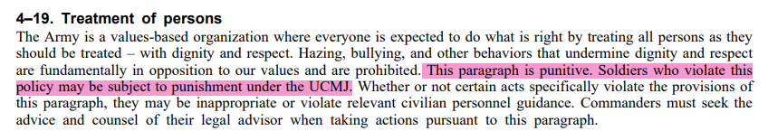
Roles
DEFINITIONS
Witness:
  Someone who we believe has some knowledge to support or to refute an allegation (may be a subject-matter expert (SME))
Subject:
  Someone against whom a non-punitive allegation is made
Suspect:
  Someone against whom a punitive * allegation is made
  *Violations of law (UCMJ & USC) are punitive offenses.
AR 20-1, Paragraph 7-1g; The A&I Guide, Part Two, Section 1-3 (II-1-9)

Slide 20

Status
ELO 1
Who is required to cooperate & when?
Military?
  Army Active Component?
  Army Reserve?
  Army National Guard?
Department of the Army Civilians?
Contractors?
Other DoD Military / Civilian Personnel?
Civilians not employed by the DoD?
  (Civilian / Civilians)
Always
When in a duty status
When in a duty status
Always
It depends
Chain of Command
Never
The A&I Guide, Part Two, Section 1-6 (II-1-17) Digital Page 203

Slide 21
ELO Check on Learning
ELO 1. Describe a person’s role and status in an IG Investigation / Investigative Inquiry.
  Witness, Subject, Suspect
  DA Civilian Employee
  Civilian-Civilian

Slide 22

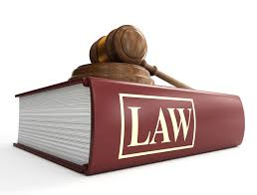
Rights and Non-Rights
Inspector General
Investigation / Investigative Inquiry
ADMINISTRATIVE DUE
PROCESS
WITNESS
SUBJECT
SUSPECT
AR 20-1, Paragraph 7-1g; Digital Page 65
The A&I Guide, Part Two, Sections 1-4 (II-1-11) &1-5 (II-1-15) / Digital Page 197 & 201

Slide 23
Rights
Based on Role
DEFINITIONS
ELO
2
WITNESS
1. Consult with Counsel (but...)
2. Confidentiality (but...)
3. Review Own Testimony (in...)
4. Avoid Self Incrimination (Stop!)
5. Have a Union Rep present (if...)
SUBJECT
1. Consult with Counsel (but...)
2. Confidentiality (but...)
3. Review Own Testimony (in...)
4. Avoid Self Incrimination (Stop!)
5. Have a Union Rep present (if...)
SUSPECT
1. Consult with Counsel (but...)
2. Confidentiality (but...)
3. Review Own Testimony (in...)
4. Avoid Self Incrimination (Stop!)
5. Have a Union Rep present (if...)
6. Know and Comment on Allegations
7. Know and Comment on
Unfavorable Information
8. Remain Silent
6. Know and Comment on Allegations
7. Know and Comment on
Unfavorable Information
8. Remain Silent
9. Subject and Witness rights...AND!
Have Article 31 Rights: Have Counsel Present
AR 20-1, Paragraph 7-1g; Digital Page 65
The A&I Guide, Part Two, Sections 1-4 (II-1-11) / Digital Page 197

Slide 24
Non-Rights
DEFINITIONS
ELO
2
Know the identity of witnesses
Be present during questioning of others
Question others
Review evidence
Audio / video record testimony [AR 20-1, 7-1b(4)(d)]
Take / Remove written notes from IG interview*
Have a friend present during questioning*
* IG / CIG has some discretion
IG confidentiality
The A&I Guide, Part Two, Sections 1-5 (II-1-15) / Digital Page 201

Slide 25
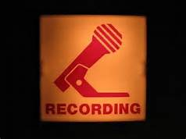
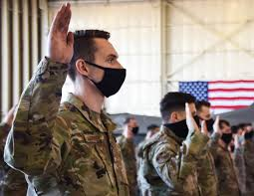

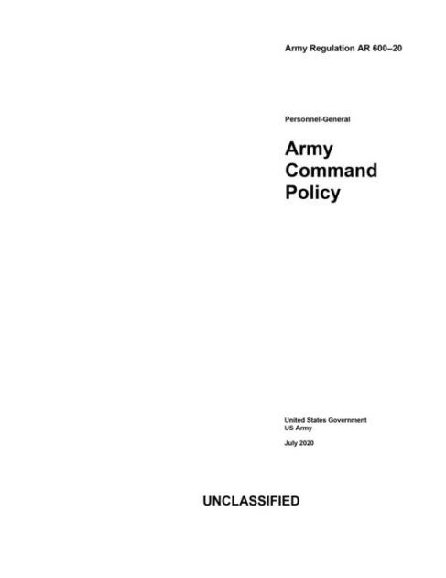
Categories of Evidence
DEFINITIONS
Recorded Under oath Documents
High
Testimony - Recorded under oath, transcribed or summarized! (sworn statement)
Physical - Objects; not common
Standard - Regulation, SOP, etc
Documents
Statements - Written
IG Personal Observation - Stay Away!
Low
The A&I Guide, Part Two, Section 1-8 (II-1-22) / Digital Page 208

Slide 26
Levels of Evidence
DEFINITIONS
ELO
3
Direct - First-hand knowledge
Circumstantial - Tends to prove or disprove an issue by inference
Hearsay - What one individual says another person said
Opinion - A person’s belief or judgment
High
Low
(D – C – H – O)
Evidence is also characterized by its quality, detail, and credibility. Always conduct a credibility assessment.
The A&I Guide, Part Two, Section 1-9 (II-1-25) / Digital Page 211

Slide 27


Fact
DEFINITIONS
ELO
3
Events that are known to have happened
Things that are known to be true
Can be a combination of testimonies, documents or physical evidence
Must independently agree on a single point
The A&I Guide, Part Two, Section 1-10 (II-1-26) / Digital Page 212

Slide 28
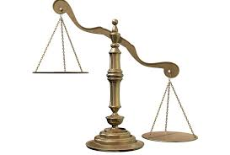
IG Standard of Proof
DEFINITION
ELO
4
Preponderance of credible evidence
  That evidence which has superiority of weight
  >50%
  "More likely than not, it probably occurred"
Only two conclusions:
Substantiated
Not Substantiated
"S"
"N"
AR 20-1, Paragraph 7-2b; Digital Page 70
The A&I Guide, Part Two, Sections 1-11 (II-1-27) / Digital Page 213

Slide 29
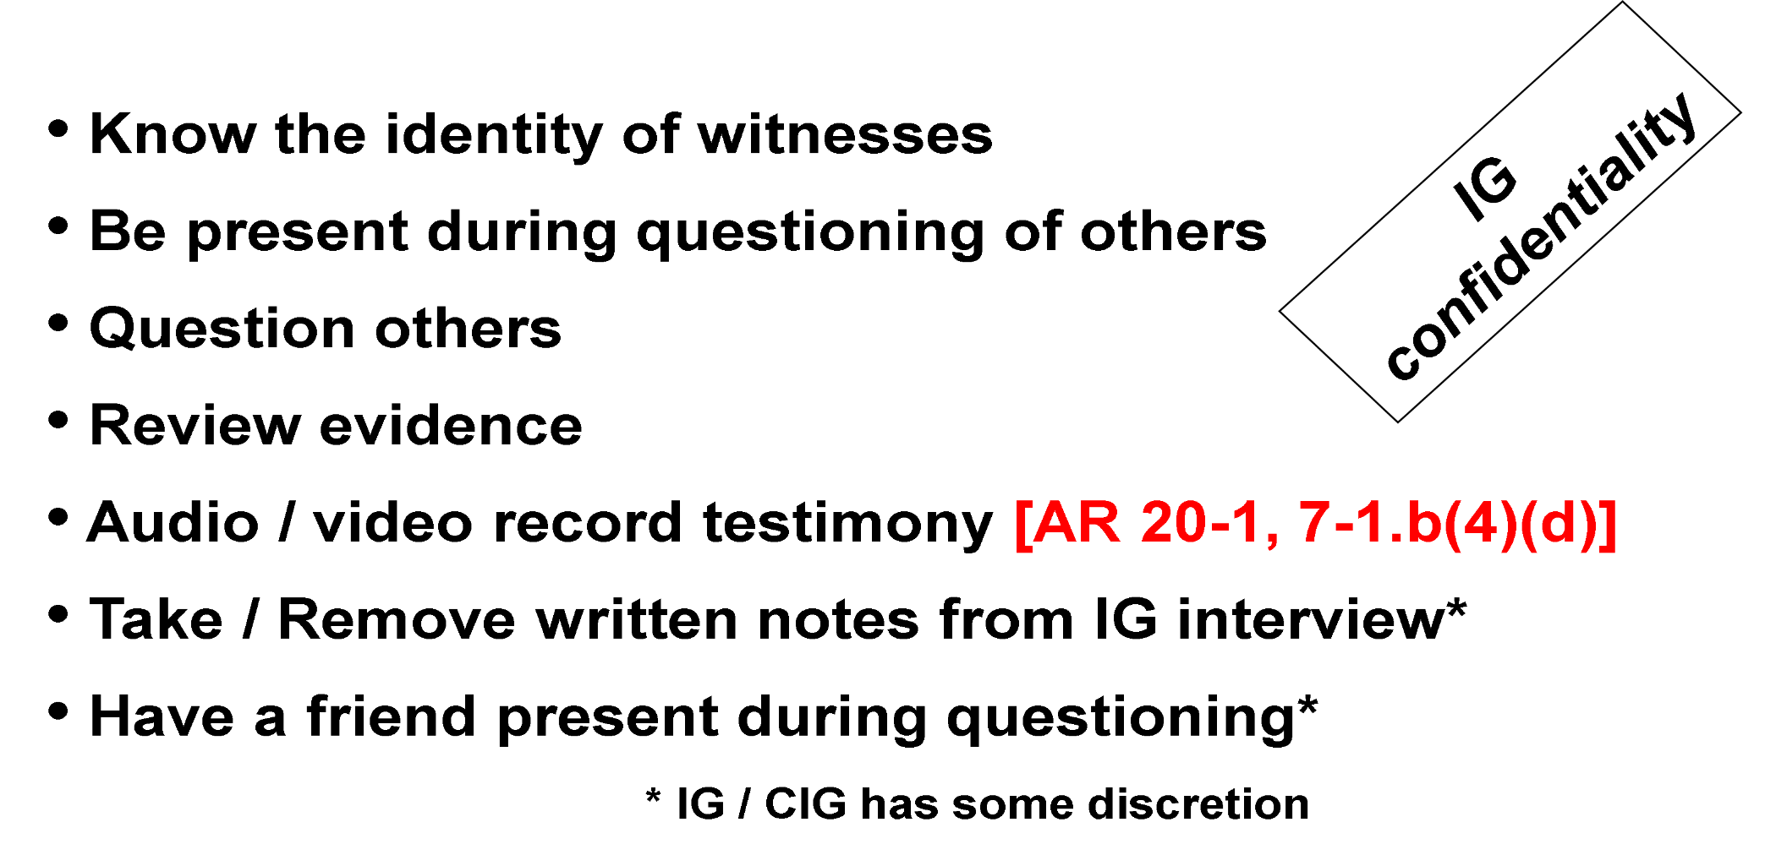
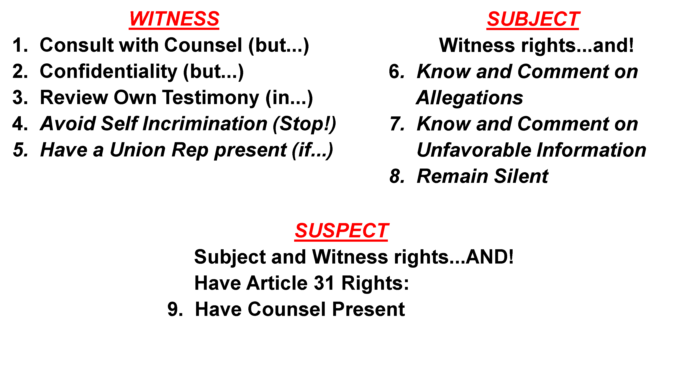
ELO Check on Learning
ELO 2. Describe an individual’s rights or non-rights given that person’s role and status.
  Witness, Subject, Suspect
ELO 3. Describe a fact and the levels of evidence used in the Investigations function.
ELO 4. Describe the IG Standard of proof.

Slide 30
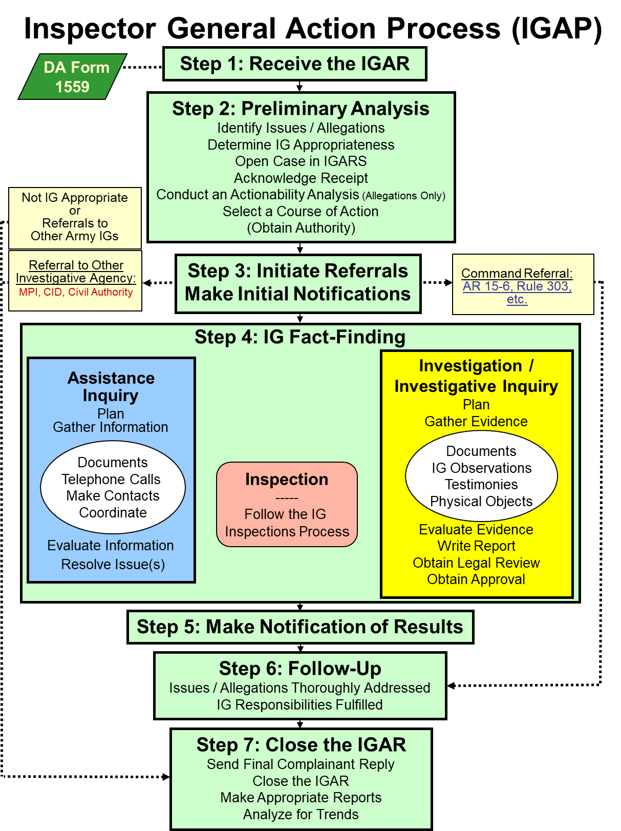
The Seven-Step IGAP
Step One
Step 1 Receive the IGAR
Anyone
IGARs come from the in crowd:
  Walk-in
  Call-in
  Write-in
  E-mail-in
  FAX-in
  gym / party / PX / bathroom / mall
  Bottom line – who can give an IGAR?
AR 20-1, paragraph 6-1d (1) and 7-1b(1) Digital Page 55 and 62
The A&I Guide, Part Two, Section 1-14 (II-1-31) / Digital Page 217

Slide 31
Complainant Disclosure
Step 1 Receive the IGAR
IG confidentiality applies, but limited upon referral to the command
Annotate consent / non-consent on DA Form 1559 to release of personal information and / or documents
  Anonymous, Consent, Partial Consent, No Consent
IGs will refer all command-appropriate allegations to the chain of command to address along with all provided documentary evidence in un-redacted form.
AR 20-1, Paragraphs 1-13e and 3-4g/ Digital Page 20 and 36;
The A&I Guide, Part Two, Section 3-1-1 (II-3-2) / Digital Page 257

Slide 32
Step Two: IG Preliminary Analysis
IGPA
Step 2 Preliminary Analysis
Identify Issues / Allegations
Determine IG Appropriateness
Open Case in IGARS
Acknowledge Receipt
Conduct An Actionability Analysis (Allegations Only)
Select a Course of Action
(Obtain Authority)
Are there any Issues?
What are the Allegations?
AR 20-1, Paragraph 6-1d(2)(b) / Digital Page 55
The A&I Guide, Part Two, Section 2-6 (II-2-12) / Digital Page 229

Slide 33

4-Part Allegation
DEFINITION
ELO
5
Who
  Must identify a named individual
Improperly
  The word “improperly” shows wrongdoing – may be implied
Did (or failed to do)
In Violation of a Standard
  A standard is law, regulation, or policy
Let’s look at a couple complaints!
The A&I Guide, Part Two, Section 2-2 (II-2-3) / Digital Page 220

Slide 34
‘Typical’ Complaint
Our director, COL Brown, is a real piece of WORK. He has a clique of cronies that get all the good deals and the rest of us don’t get anything. He also ordered new office furniture for himself and his SECRETARY. Such a waste since we’re laying off good workers! I also heard he accepted a unit gift at his change of command that cost over $480. He boasts that he is “IN TIGHT” with the General and that is why he thinks he can do whatever he wants. If you check, you can verify these things with Ms. ROSE, Mr. CALVIN, and Mr. HOBBS. They know about HIM.
A CONCERNED EMPLOYEE

Slide 35
Poorly Phrased Allegations
What do you think?
COL Robert E. Brown acted improperly in that he committed adultery with Ms. Smith on June 25th, 2014, in NJ, in violation of the UCMJ.
COL Robert E. Brown wasn't at work in violation of AR 600-20, paragraph 2-17.
Who, Improperly, Did, IVO

Slide 36
How About These?
COL Robert E. Brown improperly committed adultery in violation of Article 134 (Adultery), UCMJ.
XXXXXXXXXXX
  Effective 1 January 2019, Article 134 (Adultery) changed to Article 134 (Extramarital sexual conduct)
Be sure to use the terminology existing during the time of the alleged impropriety took place
COL Robert E. Brown engaged in Extramarital sexual conduct in violation of Article 134 (Adultery), UCMJ.
COL Robert E. Brown was improperly absent from his place of duty in violation of Article 86, UCMJ.

Slide 37

Where to Find Standards
(use the standard at the time in question)
United States Code (USC): www.law.cornell.edu/uscode/
Code of Federal Regulations (CFR): https://www.ecfr.gov/
DoD Directives: https://www.esd.whs.mil/DD/
Army Regulations: https://armypubs.army.mil
National Guard Regulations: https://www.ngbpmc.ng.mil/ngr/
Army Reserve Regulations: www.usar.army.mil/Publications/
Defense Health Agency Policies: https://info.health.mil/staff/Governance/Pages/Home.aspx
Camp, post, or station local regulations, policies, and SOPs

Slide 38

Elements of Proof
Elements of Proof: Derive from the standard and must be established in order to substantiate or not substantiate an allegation
Read what the standard says
– "don't read into it"
Conjunctions & Disjunctions count
  And,
  Or, Nor, For
  But, Yet, So
Ask your SJA for interpretation and advice
The A&I Guide, Part Two, Section 1-2 (II-1-7) / Digital Page 193

Slide 39
Elements of Proof
Manual for Courts Martial (2024 Edition) Article 134, Extramarital sexual conduct
Article 134, (Extramarital sexual conduct) UCMJ, states,
“Text of statute. See paragraph 91.”
Elements.
(1) That the accused wrongfully engaged in extramarital conduct as described in subparagraph c. (2) with a certain person;
(2) That, at the time, the accused knew that the accused or the other person was married to someone else; and
(3) That, under the circumstances, the conduct of the accused was either: (i) to the prejudice of good order and discipline in the armed forces; (ii) was of a nature to bring discredit upon the armed forces; or (iii) to the prejudice of good order and discipline in the armed forces and of a nature to bring discredit upon the armed forces.

Slide 40

Consultation with the SJA
Not required, but it is a really good idea
Helps refine allegations
Helps select proper standards
Helps identify Elements of Proof
SJA interprets regulations and law and advises the commander on the investigative COAs
The IG investigates allegations of impropriety

Slide 41
ELO Check on Learning
ELO 5. Describe the parts of an allegation.
  Parts of a properly worded allegation
  Role of the SJA

Slide 42
Step Two: IG Preliminary Analysis
IGPA
Step 2 Preliminary Analysis
Identify Issues / Allegations
Determine IG Appropriateness
Open Case in IGARS
Acknowledge Receipt
Conduct An Actionability Analysis (Allegations Only)
Select a Course of Action
(Obtain Authority)
The A&I Guide, Part Two, Section 2-7 (II-2-13) / Digital Page 230

Slide 43






Not Local IG Appropriate
Allegations against Professionals
ELO 10
Any Army lawyer (military or civilian) refer to DAIG’s Legal Advisor (AR 20-1, paragraph 7-1i (4)-(5))
IGs refer to next higher IG (AR 20-1, paragraph 7-1j)
Medical, CID Agents, Recruiters, Chaplains (The A&I Guide, Part One, Section 3-2-3)
AR 20-1, Paragraph 7-1i /Digital Page 66 The A&I Guide, Part Two, Section 2-7 (II-2-13) / Digital Page 230

Slide 44
Reasons why the IG Would NOT investigate
ELO 10
If the allegation is ‘Not Local IG Appropriate’
If the allegation involves serious criminal misconduct, the IG will not investigate! These are outside the IG purview
If substantiation and adverse action appear certain
A regulatory redress process exists (not yet exhausted)
The Commander selects another investigative option
The IG recommended another non-specific form of investigation
AR 20-1, Paragraph 7-1i(1) /Digital Page 66 The A&I Guide, Part Two, Section 2-7 (II-2-13) / Digital Page 230
Notes:
44

Slide 45
Step Two: IG Preliminary Analysis
IGPA
Step 2 Preliminary Analysis
Identify Issues / Allegations
Determine IG Appropriateness
Open Case in IGARS
Acknowledge Receipt
Conduct An Actionability Analysis (Allegations Only)
Select a Course of Action
(Obtain Authority)
The A&I Guide, Part Two, Section 2-8 (II - 2 - 16) / Digital Page 233

Slide 46
Reporting Requirements
For Allegations Against:
COL and below: Input allegations into the IGARS database within two working days
  AR 20-1, paragraph 7-1k (1), and Appendix D, Table D-1
Inspectors General: Report to the next higher-echelon IG for appropriate action and input allegations into the IGARS database and within two working days AR 20-1, paragraph 7-1j (1), and Appendix D, Table D-1

Slide 47
Step Two: IG Preliminary Analysis
IGPA
Step 2 Preliminary Analysis
Identify Issues / Allegations
Determine IG Appropriateness
Open Case in IGARS
Acknowledge Receipt
Conduct An Actionability Analysis (Allegations Only)
Select a Course of Action
(Obtain Authority)
The A&I Guide, Part Two, Section 2-10 (II-2-18) /Digital Page 235

Slide 48

Analysis Framework
The “How”
Is the allegation of impropriety connected directly to a named individual?
Is the complainant able to convey the alleged wrongdoing clearly enough for the IG to determine if a standard applies?
Does the nature of the allegation suggest that only a minor infraction occurred (Teaching and Training)?
Did the IG evaluate documents provided by the complainant or obtained by IG authority that support the possibility that an impropriety occurred?
Does the complaint and supporting evidence provide enough information to conduct a thorough investigation?
The A&I Guide, Part Two, Section 2-10 (II-2-19) / Digital Page 236

Slide 49
ELO Check on Learning
ELO 10. Determine if an allegation received by the IG is appropriate for IG action.

Slide 50
Step Two: IG Preliminary Analysis
IGPA
Step 2 Preliminary Analysis
Identify Issues / Allegations
Determine IG Appropriateness
Open Case in IGARS
Acknowledge Receipt
Conduct An Actionability Analysis (Allegations Only)
Select a Course of Action
(Obtain Authority)
The A&I Guide, Part Two, Section 2-11 (II-2-30) Digital Page 247

Slide 51
STEP 2: Conduct IGPA
Select a Course of Action
Inspection
Assistance Inquiry
Evaluate and Close
Referral (Command, Another Agency, or IG Office)
Investigation / Investigative Inquiry
The A&I Guide, Part Two, Section 3-1 (II-3-3) / Digital Page 258

Slide 52
Referring Allegations to the Command
ELO 7
IGs will formally refer ALL command-appropriate allegations to the command using a formal command referral memorandum
  Active Component Commanders will respond within 14 days;
  National Guard and Reserve units will respond within 45 days
Referral receiving commander (or agency) will:
  Select an investigative option
  Execute all notifications to Subject(s), Suspect(s), and Commander / supervisor (as appropriate)
  What can the IG tell another Army investigator?
  What can the IG tell a non-Army investigator?
The A&I Guide, Part Two, Section 3-1-1 (II-3-4) and (II-3-11) / Digital Page 258 and 266

Slide 53
Requests for IG Information
ELO
9
ELO
9
Department of the Army Investigator:
  Allegation list
  Documents not given in confidence to the IG
  Witness list with brief synopsis of relevant testimony
AR 20-1, Paragraph 3-4g; The A&I Guide, Part Three, Section 1-3
FOIA: Unofficial business
  AR 20-1, Paragraph 3-7; The A&I Guide, Part Three, Section 1-4
Review own testimony:
Witness, subject / suspect: In the IG office, but they don’t get to keep a copy
  AR 20-1, Paragraph 7-1b; The A&I Guide, Part Two, Section 1-4

Slide 54
STEP 2: Conduct IGPA
Select a Course of Action
Inspection
Assistance Inquiry
Evaluate and Close
Referral (Command, Another Agency, or IG Office)
Investigation / Investigative Inquiry
Note: Once the DA initiates an IG Investigation or Investigative Inquiry, the DA cannot terminate it, even if substantiation appears likely and adverse action may be appropriate. The IG must complete the investigation and provide the results to the DA.
The A&I Guide, Part Two, Section 1-2 (II-1-6) / Digital Page 192

Slide 55
STEP 2: Conduct IGPA
Select Course of Action
ELO
6
IG INVESTIGATIVE INQUIRY
Resolve Allegations of a less serious nature
Informal fact-finding process (Directing Authority verbal or written directive)
Written ROII
Less testimony, more statements
IG INVESTIGATION
Resolve Allegations of a more serious nature
Formal fact-finding process (Directing Authority Written Directive)
Written ROI
More testimony, less statements
Both require the same measure of proof and due diligence by the IG.
The A&I Guide, Part Two, Section 2-5 (II-2-10) / Digital Page 227

Slide 56


What the IG SHOULD Consider
ELO
11
The IG should retain the allegation, when the allegation is IG appropriate and following exists:
  It is the Directing Authority’s preference
  AND
  These factors are present:
    Lack of factual information surrounding the allegation
    Sensitivity of allegations; IGs are trained investigators
    Confidentiality is important; identities must be protected
    Protect reputations AND preserve unit cohesion
IG
Other
Notes:
56

Slide 57
Investigation or
Investigative Inquiry?
ELO
11
Factors to consider favoring an Investigation:
  The allegation is serious and could result in adverse action
  High degree of documentation is important / required
  The potential for harm to a Soldier (or Soldiers) exists
  Adversely affects the image of the Army
  May have great impact on the command
  The allegation will likely have media interest
  The Commander directs the IG to investigate
The A&I Guide, Part Two, Sections 2-11 (II-2-31) / Digital Page 248

Slide 58
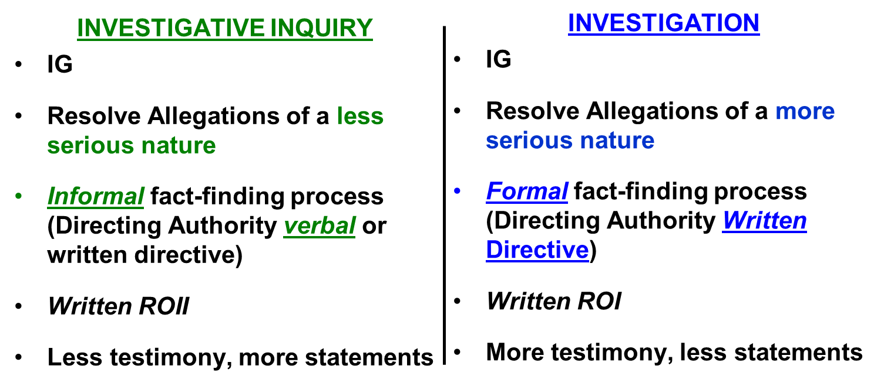
ELO Check on Learning
Factors to consider favoring an Investigation:
  The allegation is serious and could result in adverse action
  High degree of documentation is important / required
  The potential for harm to a Soldier (or Soldiers) exists
  Adversely affects the image of the Army
  May have great impact on the command
  The allegation will likely have media interest
  The Commander directs the IG to investigate
ELO 6. Describe an IG Investigation and an IG Investigative Inquiry and the differences between them.
ELO 7. Describe the procedures for referring allegations of impropriety to the command.
ELO 10. Determine if an allegation received by the IG is appropriate for IG action.
ELO 11. Explain which IG method – Investigative Inquiry or Investigation – is preferable for a particular case.
IGs will formally refer ALL command-appropriate allegations to the command using a formal command referral memorandum

Slide 59
Referrals and Make Initial Notifications
Step 3
Step 3 Initiate Referrals
Make Initial Notifications
The A&I Guide, Part Two, Chapter 3 (II - 3 – 1) / Digital Page 256

Slide 60
Initiate Referrals
(Step 3)
If a non-IG investigative option is selected, refer the allegations to the command or agency for action using a formal command referral memorandum
The allegation becomes a command activity. The IGs will:
IGs monitor the progress
Review the resulting command product to verify the command addressed the nature of the allegation referred by the IG; DO NOT evaluate the quality of the command product
If the entire referral is properly addressed, close the case in IGARS as “Command Referred”
  AR 20-1, Paragraphs 7-1b(3) / Digital Page 63;
  The A&I Guide, Part Two, Section 3-1 (II-3-3) / Digital Page 258

Slide 61
Referring Allegations to the Command
ELO 7
If the command product DID NOT address the allegations:
  1. Address with the responsible Commander to resolve
  If still not in agreement…
  2. Address with next higher Commander
  If still not in agreement…
  3. Consult with the SJA and present to the Directing Authority
  If still not in agreement…
  4. Present to next higher IG office, annotate action in case note and close the case in IGARS as “Command Referred”
The A&I Guide, Part Two, Section 3-1-1 (II-3-5) /Digital Page 260

Slide 62
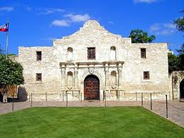
ALAMO Case Study
(Course Material- Day 8- PE# 1)

Slide 63
ALAMO Case Study
Step 1
Step 1 Receive the IGAR
PE #1 - LTC Bowie
(Course Material- Day 8- PE# 1)
What are the issues and allegations?
Who is the subject / suspect?
What’s the next step in the IGAP?
AR 20-1, paragraph 6-1d (1) and 7-1b(1) Digital Page 55 and 62
The A&I Guide, Part Two, Section 1-14 (II-1-31) / Digital Page 217

Slide 64

ALAMO Case Study
Step 2: IGPA
Step 2 Preliminary Analysis
Identify Issues / Allegations
Determine IG Appropriateness
Open Case in IGARS
Acknowledge Receipt
Conduct An Actionability Analysis
(Allegations Only)
Select a Course of Action
(Obtain Authority)
Let’s talk to the
complainant…
PE #2
Do we have clarification on the issues and allegations?
AR 20-1, Paragraph 6-1d(2)(b) / Digital Page 55
The A&I Guide, Part Two, Section 2-6 (II-2-12) / Digital Page 229

Slide 65
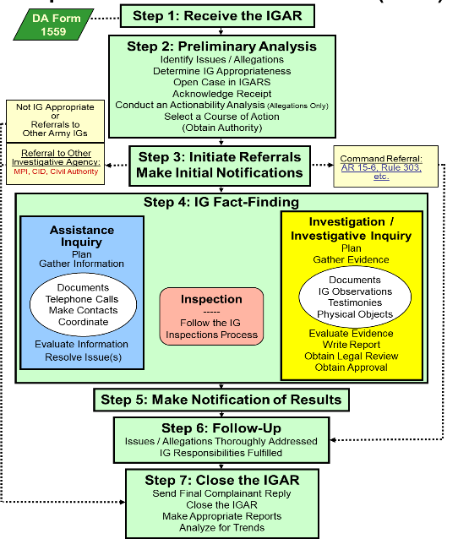
ALAMO Case Study
Step 2: IGPA
Step 2 Preliminary Analysis
Identify Issues / Allegations
Determine IG Appropriateness
Open Case in IGARS
Acknowledge Receipt
Conduct An Actionability Analysis
(Allegations Only)
Select a Course of Action
(Obtain Authority)
What standards apply?
Who can help determine and refine standard selection?
Punitive or Non-Punitive?
Let’s talk to the SJA… PE #3
AR 20-1, Paragraph 6-1d(2)(b) / Digital Page 55
The A&I Guide, Part Two, Section 2-6 (II-2-12) / Digital Page 229

Slide 66
4-Part Allegation
#1 COL Santa Anna improperly mistreated his subordinates in violation of Army Regulation (AR) 600-20, paragraph 4-19.
#2 COL Santa Anna improperly relieved a subordinate commander in violation of AR 600-20, paragraph 2-17.
xxxxxxxxxxxx
Which version of AR 600-20 was in effect at the time?
Who, Improperly, Did, IVO

Slide 67
Elements of Proof
AR 600-20 (6 November 2014), paragraph 4-19,
Treatment of persons
  The Army is a values-based organization where everyone is expected to do what is right by treating all persons as they should be treated – with dignity and respect. Hazing, bullying, and other behaviors that undermine dignity and respect are fundamentally in opposition to our values and are prohibited. This paragraph is punitive.
  What are the elements of proof of this standard?

Slide 68
Elements of Proof
AR 600-20, paragraph 2-17
Relief for Cause
a. When a higher-ranking commander loses confidence in a subordinate commander’s ability to command due to misconduct, poor judgment, the subordinate’s inability to complete assigned duties, or for other similar reasons, the higher-ranking commander has the authority to relieve the subordinate commander.
  1. Must counsel unless inappropriate or impractical under the circumstances.
  2. Commander may temporarily suspend but must get final written approval from the first general officer in the chain of command.
  3. Action is temporary until the first general officer in the chain of command submits his or her written approval.
"BUT"
b. If relieved as a result of an AR 15-6 investigation, then
  1. Referral and comment procedure of that regulation must be followed.
  2. Relieved officer may be temporarily suspended pending completion of the procedural safeguards contained in AR 15-6.
  3. Action to relieve before completion of the procedural safeguards of
  AR 15-6 is a temporary suspension.

Slide 69
ALAMO Case Study
Step 2: IGPA
Step 2 Preliminary Analysis
Identify Issues / Allegations
Determine IG Appropriateness
Open Case in IGARS
Acknowledge Receipt
Conduct An Actionability Analysis
(Allegations Only)
Select a Course of Action
(Obtain Authority)
Is this IG Appropriate?
Why or why not?
What are the IG’s reporting requirements?
The A&I Guide, Part Two, Section 2-7 (II-2-13) / Digital Page 230

Slide 70
ALAMO Case Study
Step 2: IGPA
Step 2 Preliminary Analysis
Identify Issues / Allegations
Determine IG Appropriateness
Open Case in IGARS
Acknowledge Receipt
Conduct An Actionability Analysis
(Allegations Only)
Select a Course of Action
(Obtain Authority)
The A&I Guide, Part Two, Section 2-8 (II - 2 - 16) / Digital Page 233

Slide 71
Reporting Requirements
For Allegations Against:
COL and below: Input allegations into the IGARS database within two working days
  Command or Local IG can inquire / investigate
  AR 20-1, paragraph 7-1k (1), and Appendix D, Table D-1
Inspectors General: Report to the next higher-echelon IG for appropriate action and input allegations into the IGARS database and within two working days AR 20-1, paragraph 7-1j (1), and Appendix D, Table D-1

Slide 72
ALAMO Case Study
Step 2: IGPA
Step 2 Preliminary Analysis
Identify Issues / Allegations
Determine IG Appropriateness
Open Case in IGARS
Acknowledge Receipt
Conduct An Actionability Analysis
(Allegations Only)
Select a Course of Action
(Obtain Authority)
Acknowledge Receipt…. PE #4
AR 20-1, Paragraph 6-1d(2)(a) / Digital Page 55;
The A&I Guide, Part Two, Section 2-9 (II-2-17) / Digital Page 234

Slide 73
ALAMO Case Study
Step 2: IGPA
Step 2 Preliminary Analysis
Identify Issues / Allegations
Determine IG Appropriateness
Open Case in IGARS
Acknowledge Receipt
Conduct An Actionability Analysis
(Allegations Only)
Select a Course of Action
(Obtain Authority)
The A&I Guide, Part Two, Section 2-10 (II-2-18) /Digital Page 235

Slide 74
Analysis Framework
The “How”
Is the allegation of impropriety connected directly to a named individual?
Is the complainant able to convey the alleged wrongdoing clearly enough for the IG to determine if a standard applies?
Does the nature of the allegation suggest that only a minor infraction occurred (Teaching and Training)?
Did the IG evaluate documents provided by the complainant or obtained by IG authority that support the possibility that an impropriety occurred?
Does the complaint and supporting evidence provide enough information to conduct a thorough investigation?
The A&I Guide, Part Two, Section 2-10 (II-2-19) / Digital Page 236

Slide 75
IG Preliminary Analysis
Step 2: IGPA
IGPA
Step 2 Preliminary Analysis
Identify Issues / Allegations
Determine IG Appropriateness
Open Case in IGARS
Acknowledge Receipt
Conduct An Actionability Analysis
(Allegations Only)
Select a Course of Action
(Obtain Authority)
Prepare to Select a Course of Action
What should the IG consider?
Investigative Inquiry or Investigation?
The A&I Guide, Part Two, Section 2-11 (II-2-30) Digital Page 247

Slide 76
Prepare To Obtain Authority –
Investigative Inquiry
(Informal Fact-Finding)
ELO 6
Requires Directing Authority to initiate
  Verbal guidance to CIG
  Written
Based on Commander’s guidance (CCIRs)
Results in an ROII
The A&I Guide, Part Two, Section 2-12 (II-2-34) / Digital Page 251

Slide 77


Prepare To Obtain Authority–
Investigation
(Formal Fact-Finding)
ELO 6
Based on Commander’s guidance (CCIRs)
Requires a written Directive from the directing authority (CG / TAG / TIG)
The IG leading the investigation normally prepares the Action Memorandum and the Directive
The CIG normally briefs the directing authority to request signature on the Directive
Results in an ROI
The A&I Guide, Part Two, Section 2-12 (II-2-34) / Digital Page 251

Slide 78
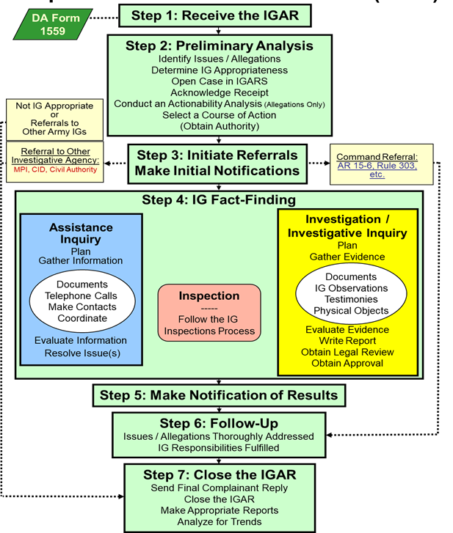
ALAMO Case Study
Step 2: IGPA
Step 2 Preliminary Analysis
Identify Issues / Allegations
Determine IG Appropriateness
Open Case in IGARS
Acknowledge Receipt
Conduct An Actionability Analysis
(Allegations Only)
Select a Course of Action
(Obtain Authority)
Who writes the Action Memo?
Who signs the Action Memo?
Who sees the Directive?
PE #5
The A&I Guide, Part Two, Section 2-12 (II-2-34) / Digital Page 251

Slide 79
Action Memorandum
Gives background information
States the allegation(s)
Summarizes the entire case, thus far
Provides the scope and the
limits of the investigation (left and
right limits)
Includes SJA opinion
Recommends approval to proceed
Signed by the Command IG
This is pre-decisional: NOT RELEASABLE
FOIA
The A&I Guide, Part Two, Section 2-11 (II-2-34), Template: (II-2-36) / Digital Page 251 and 253

Slide 80
The Directive
Authorizes the investigation or inquiry
General description of the allegation
  Names are not included to protect confidentiality
  Directive IS RELEASABLE and presented to all those necessary to show your authority
Signed by the Directing Authority
subject to
FOIA
The A&I Guide, Part Two, Section 2-11 Template (II-2-37) / Digital Page 254

Slide 81

Action Memo + Directive
ELO 8
(The Agreement)
Ensures a clear, mutual understanding
between the IG and the directing authority
concerning who and what to investigate
The IG’s "order" from the Directing Authority

Slide 82

Written Investigative Plan
DEFINITION
ELO
8
An IG Investigation / Investigative Inquiry requires a written investigative plan (working document / pre-decisional)
A written investigative plan must include 3 things:
  Witness list including complainant, SMEs, and subject / suspect
  Itinerary / schedule: time, location, and sequence of Interviews
  Interrogatories / Interview Questions
The A&I Guide, Part Two, Section 4-2 (II-4-3) and Template (II-4-7) / Digital Page 282 and 286

Slide 83

ELO Check on Learning
ELO 6. Describe an IG Investigation and an IG Investigative Inquiry and the differences between them.
ELO 8. Describe how an IG plans an Investigative Inquiry or Investigation
  Action Memo + Directive
  Written Investigative Plan
ELO 9. Describe a request for IG information and the proper actions taken by the IG.
  Review of Testimony
  Follow on DA Investigator

Slide 84
Written Investigative Plan
ELO
8
A written investigative plan must include 3 things:
  Witness list including complainant, SMEs, and subject / suspect
How many witnesses will we interview?
  MINIMUM NUMBER NECESSARY to substantiate or refute the allegation(s) – you decide, IG!
  Itinerary / schedule: time, location, and sequence of Interviews
  Interrogatories / Interview Questions
The A&I Guide, Part Two, Section 4-2 (II-4-3) /Digital Page 282

Slide 85


Interview Questions
Development
1. Identify the Allegation and Standard
Allegation: COL Brown engaged in extramarital sexual conduct with his secretary in violation of Article 134, Uniform Code of Military Justice (UCMJ).
Article 134: Though not specifically mentioned in this chapter, all disorders and neglects to the prejudice of good order and discipline in the armed forces, all conduct of a nature to bring discredit upon the armed forces, and crimes and offenses not capital, of which persons subject to this chapter may be guilty, shall be taken cognizance of by a general, special, or summary court-martial, according to the nature and degree of the offense, and shall be punished…..
2. Outline the Elements of Proof
That the accused wrongfully had sexual intercourse with a certain person
At the time, the accused or the other person was married to someone else; AND
The conduct of the accused was to the prejudice of good order and discipline in the armed forces; OR
The conduct was of a nature to bring discredit upon the armed forces
3. Outline what’s required to:
Substantiate:
Confirmation that one or both parties were married at the time of the incident
Identify instances where the relationship negatively impacted the unit cohesion, morale, the mission, and/or climate
The accused behavior misrepresented the organization’s credibility
Not Substantiate:
A divorce decree is presented with a timeline
Consent/family agreement or approval
Presented no impact or unfavorable image of the organization
No evidence supporting such behavior took place

Slide 86
Interview Questions
(cont'd)
It’s been a while.
When did this intimate
relationship begin?
A
We have an intimate and
romantic relationship.
After my divorce.
Q
Describe the nature of
your relationship with
Ms. Smith.
I don 't know. Ask them.
A
What about your relationship
might others perceive as
improper?
A
Q
It is both professional and personal.
We spend a lot of time together.
Be prepared to adjust and to change the focus of your questioning based on the answers.
The A&I Guide, Part Two, Appendix A (II-A-4) / Digital Page 547

Slide 87

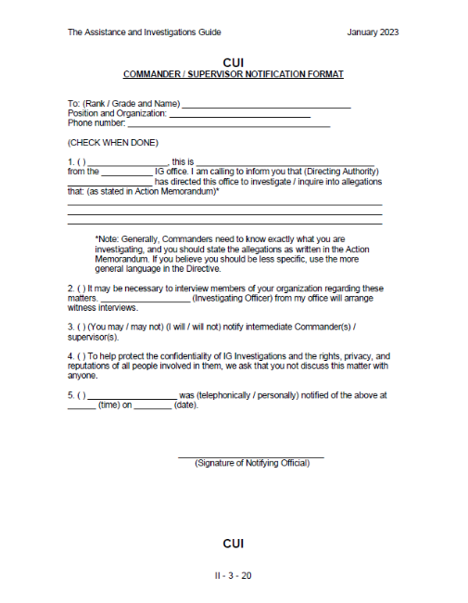
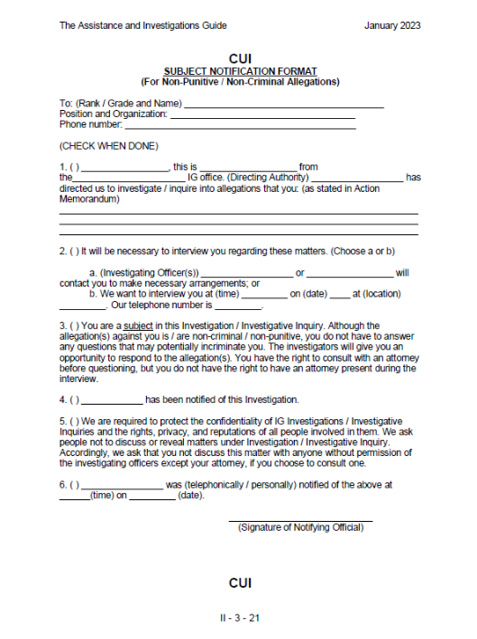
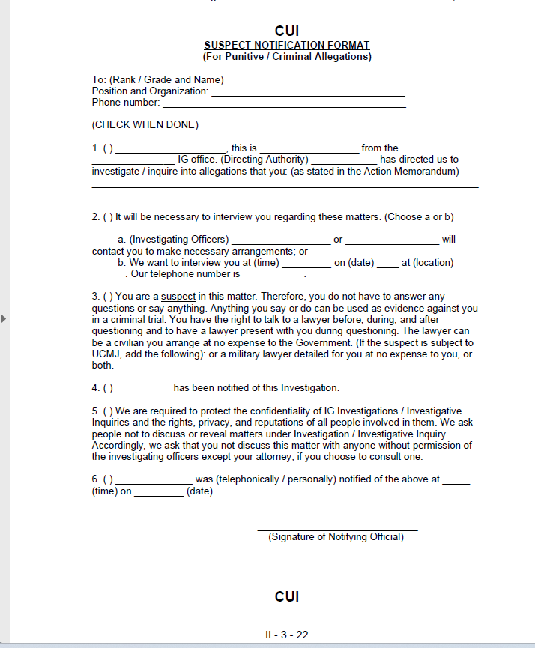
ALAMO Case Study
Step 3
Step 3: Initiate Referrals
Make Initial Notifications
The A&I Guide, Part Two, Section 3-2 (II-3-20) / Digital Page 275

Slide 88
Make Initial Notifications
(Step 3)
Verbally notify appropriate commanders and / or supervisors of the investigation (inquiry) and inform them of the nature of the allegations
Verbally notify the subjects or suspects of the investigation (inquiry) and inform them of the nature of the allegations, or the specific allegations
Record notifications in IGARS and in the ROI / ROII
  The A&I Guide, Part Two, Section 3-2 (II-3-16) Digital Page 271

Slide 89
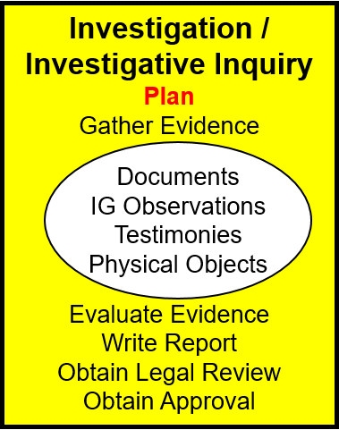
ALAMO Case Study
Step 4: Plan
PE #7 What’s missing?
Expect to change your plan!
The A&I Guide, Part Two, Section 4-2 (II-4-3) and Template (II-4-7) / Digital Page 282 and 286

Slide 90
Execute Your Plan
(Step 4)
ELO
8
How many witnesses will we interview?
  MINIMUM NUMBER NECESSARY to substantiate or refute the allegation
Throughout interviews and the investigation, collect and review documents continuously
Command Products can be used as a piece of evidence to resolve allegations of impropriety

Slide 91

Gather Evidence
(Step 4)
ELO
12
Create an Evidence Matrix ....
Collect documents ...........
Collect physical evidence ..........................
Conduct interviews:
  Complainant ..................
  Experts ....................................
  Witnesses (How Many?)....................
  Subjects / Suspects ............................

Slide 92
OTR 16-0021
Evidence Matrix
(PE 8a Evidence Matrix)
 | Mistreatment | Improper Relief | Other/Due Outs
LTC Bowie | BN Commanders confronted Santa Anna Mrs. Santa Anna threatened to have him relieved and COL Santa Anna ratified the threat "my wife speaks for me" Has not received his OER COL Santa Anna removed BN S-3 just before deployment Mrs. Santa Anna abusive, COL Santa Anna did not intervene | Believes he was relieved in theater because CDR did not like wife COL Santa Anna claimed relief was for poor judgment COL Santa Anna threatened Bowie; get wife under control or be relieved (page 6) BG Klink warned LTC Bowie Santa Anna "out to get him" Relieved March 6 | Interview LTC Ewing, LTC Crockett, LTC Houston, MAJ Rose, and Ursula Bowie Consult with SJA, re: FRG coordinator cooperation requirements
E-mail | "If you cannot get your wife under control, then I will find someone who can. Signed Gunfighter Six." | "If you cannot get your wife under control, then I will find someone who can. Signed Gunfighter Six."
MAJ Rose
LTC Crockett
LTC Ewing
Betty Santa Anna
COL Santa Anna
Organize
Your data
Early & often
TIMELINE (according to LTC Bowie)
Santa Anna
command
Disagreement
and Email
Deployed OEF
Ordered to Report
LTC Bowie
Relieved
Complaint
Letter
LTC Bowie
Interview
OCT
DEC
MAR
5 MAR
6 MAR
14 APR
17 APR
  The A&I Guide, Part Two, Section 4-2 (II-4-10) / Digital Page 289

Slide 93
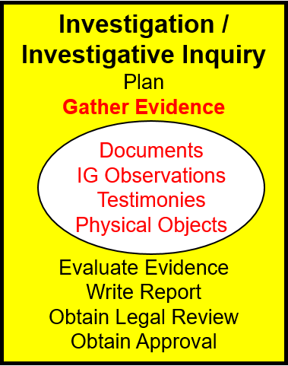
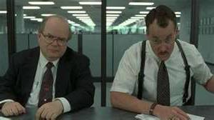
ALAMO Case Study
Step 4: Gathering Evidence
(PE 8b Gather Evidence)
PE #8b
Let’s search the web and other documents
Let’s interview LTC Ewing and LTC Crocket
Update the Matrix and Timeline!

Slide 94
ALAMO Case Study
Step 4: Gathering Evidence
PE #9
Let’s interview MAJ Rose
What did we get?
Update the Matrix and Timeline!

Slide 95
ALAMO Case Study
Step 4: Gathering Evidence
PE #10
Let’s interview LTC Houston
What did we get?
Update the Matrix and Timeline!
AR 20-1, Paragraph 7-1b(4); The A&I Guide, Part Two, Section 4-3 (II-4-12) / Digital Page 291

Slide 96

Four-Part Interview
Pre-brief (not recorded – never off the record)
Read-in (recorded)
Questioning (recorded)
Read-out (recorded)
Prepare using Appendix B: Interview Prep Book
The A&I Guide, Part Two Section 4-8 (II-4-25) / Digital Page 304

Slide 97
Interview: Part 1
Establish
rapport
1. Pre-brief (explain in plain English)
  The IG interview process and IG confidentiality
  The IG's Role
  Privacy Act
  Header Sheet
  Rights Warning
  Swearing / Affirming Oaths
  Filling in documents and forms
  **Approximately 5-15 Minutes
Lay down the
ground rules
Observe baseline behavior of the witness’s speech and mannerisms.
(as an IG, not as an "Interrogator")
The A&I Guide, Part Two, Section 4-8 (II-4-26) and Appendix B (II – B – 2) / Digital Page 305 and 565

Slide 98
Interview Parts 2, 3 + 4
2. Read-in (recorded): Verbatim
3. Questioning (recorded): Rehearse this one the most! Follow interrogatory BUT listen to the witness's answers and adjust accordingly.
You may stop the recorder...
but you are never off the record.
4. Read-out (recorded): Verbatim
The A&I Guide, Part Two, Section 4-8 (II-4-28) and Appendix B (II – B – 12) / Digital Page 307 and 575

Slide 99
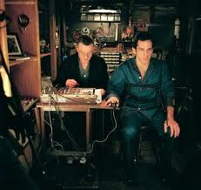
Successful Interviews
Preparation & Rehearsal
IG Attitude & Demeanor
IG ability to:
Put the witness at ease
Maintain impartiality
Adapt to the unexpected
LISTEN! LISTEN! LISTEN!
OBSERVE!
No Surprises - No Trickery
IG must ask the questions necessary to uncover credible evidence that address elements of proof!
The A&I Guide, Part Two, Appendix A, II - A – 13 / Digital Page 556

Slide 100

Interviews
AVOID:
  Being defensive / aggressive
  Interrupting the witness
  Asking:
    Yes or No questions
    Leading questions
    Irrelevant questions
    DO NOT:
  Lose control of interview
  Lose your temper
  Give advice or counsel
  Be intimidated
Let’s see what NOT To Do!

Slide 101
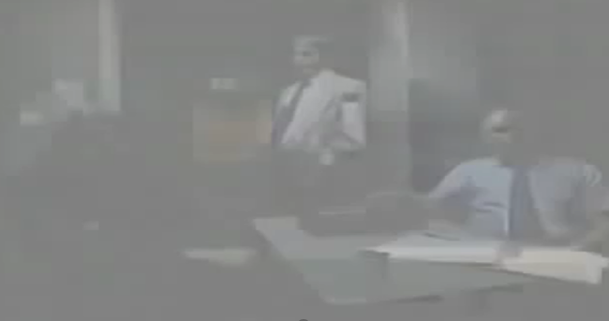
Interviews:
What NOT To Do!

Slide 102
ELO Check on Learning
ELO 12. Demonstrate evidence-gathering activities by reviewing documents; analyzing data; and interviewing witnesses, subjects, or suspects.
  Four Parts of an IG interview
  Appendix A and B
  Interrogatory Development
  Rehearsals

Slide 103

Telephonic Witness Interview
Four-Part Interview process
Pre-brief
Read-in
  - Which script?
Interrogatory questions
Read-out
Let’s interview Dr. Betty Santa Anna! – PE #11

Slide 104
Witness Interview

Slide 105
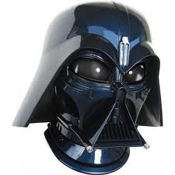
Suspect Interview
Lawyers Section 4-9 (II-4-19) / page 298 and II - B – 26 / page 589
DA 3881 Required Section 4-9 (II-4-34) / page 313
"Liar's Paragraph" Appendix B (II-B-14) / page 577
TIGS LAWYER VIDEO

Slide 106
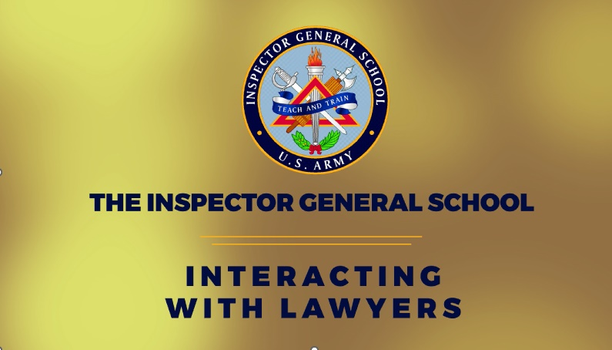
Suspect Interview
The Attorney Brief
The A&I Guide, Part Two, Appendix B, II - B - 2 / Digital Page 565

Slide 107
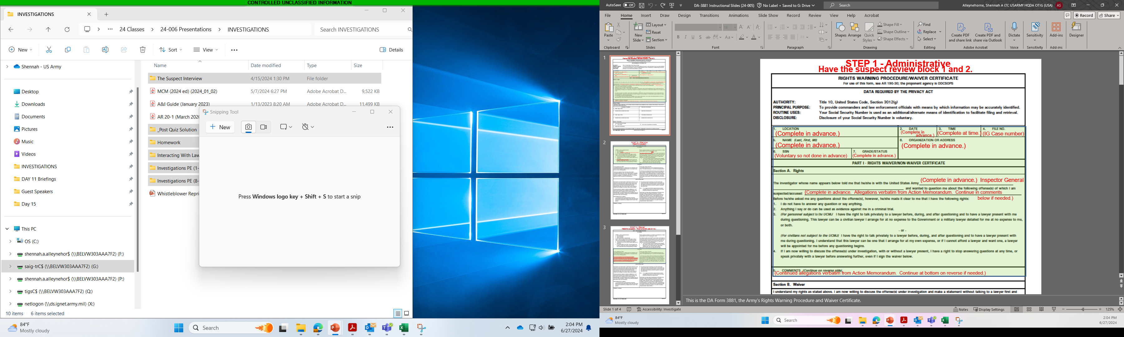
Rights Warning Procedure
(DA FORM 3881)
ELO
2
STEP 1 – Administrative Data Points
Have the suspect review blocks 1 and 2
The A&I Guide, Part Two, Section 4-9 (II-4-34) / Digital Page 313

Slide 108
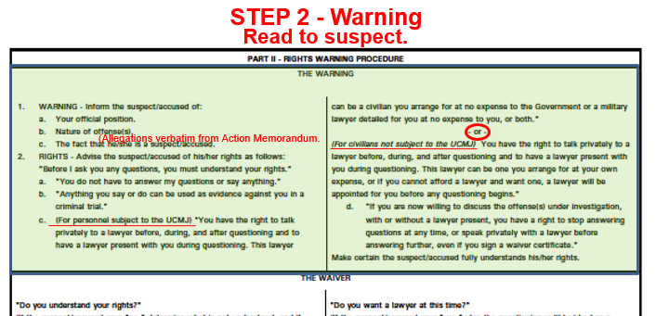
Rights Warning Procedure
(DA FORM 3881)
ELO
2
The A&I Guide, Part Two, Section 4-9 (II-4-34) / Digital Page 313

Slide 109
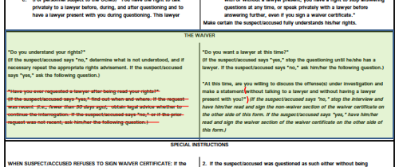
Rights Warning Procedure
(DA FORM 3881)
ELO
2
STEP 3 - Waiver
Read to suspect. Must answer yes or no.
The A&I Guide, Part Two, Section 4-9 (II-4-34) / Digital Page 313

Slide 110
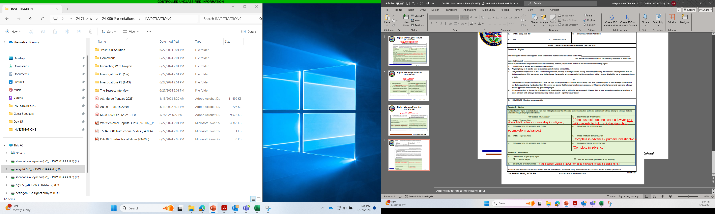
Rights Warning Procedure
(DA FORM 3881)
ELO
2
STEP 4 - Signature
The A&I Guide, Part Two, Section 4-9 (II-4-35) / Digital Page 314

Slide 111

Suspect Interview
Four-Part Interview process
Pre-brief
Read-in
  - Which script?
Questions
Read-out
TIGS SUSPECT VIDEO
PE #12- Prepare for Suspect Interview
(same sequence - different script / different documents)

Slide 112

Suspect Interview

Slide 113
Attorney Brief

Slide 114
Suspect Interview

Slide 115
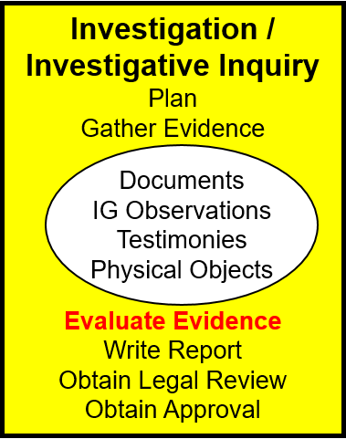
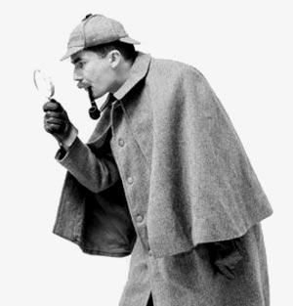
ALAMO Case Study
Step 4: Evaluate Evidence
Transcripts, Documents, Anything Else?
Now update your Evidence Matrix, witness list, and your interview questions!!!
The A&I Guide, Part Two, Section 1-11 (II-1-27) / Digital Page 213

Slide 116

Evaluate the Evidence
(Step 4)
Analyze for accuracy, veracity, and relevance
Check for inconsistencies and corroboration
Summarize redundancies
Determine and correct voids
Draw clear and supported
conclusions
Use your best judgment
Complete your Evidence Matrix

Slide 117
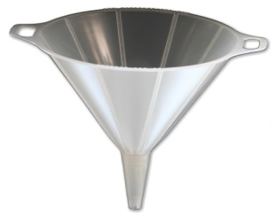
#2: COL Santa Anna improperly relieved a subordinate commander in violation of Army Regulation (AR) 600-20, paragraph 2-17. (Also list the elements of proof here)
Force-Field Diagram
(Step 4)
Prepare a diagram for each allegation
documents
testimony
physical evidence
‘S’ubstantiate
statements
EVIDENCE
‘N’ot Substantiate
Elements
of proof
'filter'
(D)
(C)
(H)
(O)
The A&I Guide, Part Two, Sections 1-11 (II-1-28) and Figure II-4-4 (II-4-41) / Digital Page 214 and 320

Slide 118
Report of Investigation / Report of Investigative Inquiry
ELO 13
2. (S/N) Allegation:
a. b. c.
3. (U/F) Issue:
a. b. c.
4. (U/F) Issue:
a. b. c.
Importance of the ROI / ROII
Resolve Allegations of Impropriety using a Report of Investigation (ROI)
The official record of the case
Presents decision makers with facts, analysis, conclusions, and recommendations
May be subject to a personnel screening process ISO centralized selection boards
Impacts careers
Consideration of Allegations / Issues
1. (S/N) Allegation:
a. Evidence
(1) Standard
(2) Document
(3) Testimony
b. Discussion (3 parts)
(1) Evidence>S
(2) Evidence>N
(3) Analysis
c. Conclusion
Other Matters:
1. (1st matter)
2. (2nd matter)
3. Unfavorable info:
Introduction Paragraph
Name / position
Authority
Background
Recommendations:
1. Approve & close
2. Fix the issue
3. Fix the issue
4. Fix 1st [other] matter
5. Fix 2nd [other] matter
The A&I Guide, Part Two, Sections 4-13 (II-4-42), II-D-1 / Digital Page 321 and 603

Slide 119
ROI / ROII
ELO 13
How you write the ROI
PURPOSE: The ultimate purpose of this section is to present everything the IG considered in determining the preponderance of credible evidence
1. (SUB/ NOT SUB) ALLEGATION: Restate the allegation as directly from the Action Memorandum, beginning with substantiated allegations. Each allegation has its own “Consideration” paragraph (1a through 1c)
Consideration of Allegations / Issues
(S/N) Allegation:
a. Evidence
(1) Standard
(2) Document
(3) Testimony
b. Discussion
(1) Evidence>S
(2) Evidence>N
(3) Analysis
c. Conclusion
Evidence: (No analysis/State Facts)
(1) Cite and describe the standards. Summarize (if the standard is longer than a paragraph) or quote verbatim the guidance contained in regulations, policies, or the UCMJ.
(2) Introduce each item of documentary evidence (separately) specifically pertaining to this allegation (i.e., ORBs, Flight Manifest, Conference Agenda, receipts, etc.) and its significance to the allegation
(3) Introduce the complainant’s testimony first, and the subject’s/suspect's testimony last, and all other evidence between.
Testimony paraphrasing and summaries are more appropriate than direct quoting, unless difficult and laborious to capture the substance and sentiment of that piece of key testimony.

Slide 120
ROI / ROII
ELO 13
How you write the ROI
USE THIS FOR YOUR HOMEWORK
PURPOSE: The ultimate purpose of this section is to present everything the IG considered in determining the preponderance of credible evidence
1. (SUB/ NOT SUB) ALLEGATION: Restate the allegation as directly from the Action Memorandum, beginning with substantiated allegations. Each allegation has its own “Consideration” paragraph (1a through 1c)
Consideration of Allegations / Issues
(S/N) Allegation:
a. Evidence
(1) Standard
(2) Document
(3) Testimony
b. Discussion
(1) Evidence>S
(2) Evidence>N
(3) Analysis
c. Conclusion
b. Discussion: (Concise evidence evaluation/Tell the story)
(1) Summarize the key evidence that tended to substantiate the allegation. (Narrative Format)
(2) Summarize the key evidence that tended to not substantiate the allegation. (Narrative Format)
(3) Apply analysis here. The burden is upon the IG to logically (step-by-step) and clearly lay out the evidence. Reasoning, critical-thinking, and writing skills are crucial. This is comprehensive narrative. Recommended Format:
Summarize the elements of proof pertaining to this allegation.
Articulate the evidence that support & refute the allegation (with specific examples)
Identify key evidence that led to the conclusion
Balance conflicting opinions by considering evidence supporting the offered opinion
Discussion of how the evidence & facts relate to the elements of proof. (Compare actions taken to the actions authorized/required)
Demonstrate where the preponderance credible evidence lies
The A&I Guide, Part Two, Section 4-13, II-4-46, II-4-53, II-4-64, and Appendix D

Slide 121
ROI / ROII
ELO 13
How you write the ROI
USE THIS FOR YOUR HOMEWORK
PURPOSE: The ultimate purpose of this section is to present everything the IG considered in determining the preponderance of credible evidence
1. (SUB/ NOT SUB) ALLEGATION: Restate the allegation as directly from the Action Memorandum, beginning with substantiated allegations. Each allegation has its own “Consideration” paragraph (1a through 1c)
Consideration of Allegations / Issues
(S/N) Allegation:
a. Evidence
(1) Standard
(2) Document
(3) Testimony
b. Discussion
(1) Evidence>S
(2) Evidence>N
(3) Analysis
c. Conclusion
The conclusion is a concise definitive statement:
“[State the allegation exactly as written] was substantiated” or “. . … was not substantiated.”
The allegation that (name) improperly (unless wrongdoing is clearly inherent in the language) (did or failed to do something) in violation of (standard) was Substantiated or was Not Substantiated.
The only conclusions for allegations in an IG Investigation or Investigative Inquiry are “Substantiated” and “Not Substantiated.”
The A&I Guide, Part Two, Section 4-13, II-4-46, II-4-53, II-4-64, and Appendix D

Slide 122
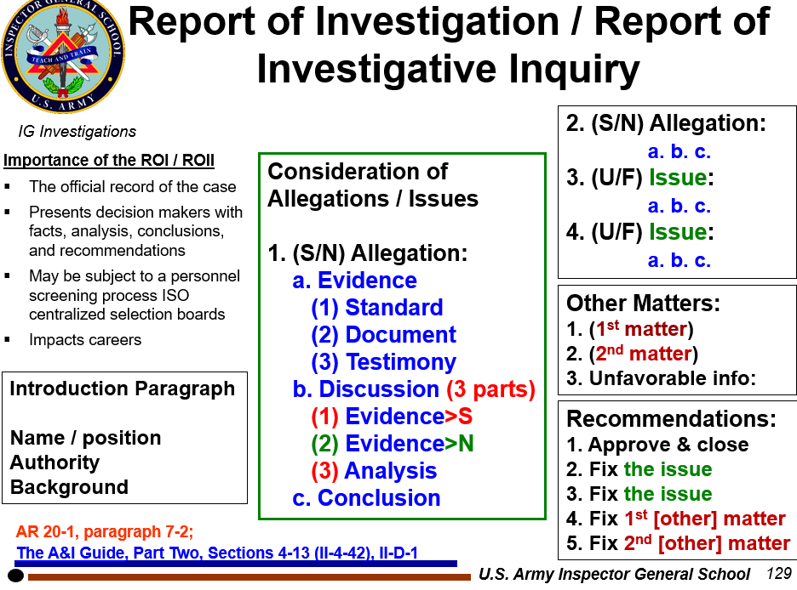
Other Matters and Recommendation(s)
USE THIS FOR YOUR HOMEWORK
OTHER MATTERS:
1. Issue the commander must address
2. Issue awareness for the commander
{do not introduce 'new' evidence or issues}
RECOMMENDATIONS:
1. Approve the report and close the case
2. Address each OTHER MATTER with a recommendation
3. Address each OTHER MATTER with a recommendation
(Always first!)
IGs never recommend adverse action; recommending administrative action to correct a mistake is appropriate. For instance, recovering an unauthorized BAH or TDY payment is not an adverse action.
The A&I Guide, Part Two, Section 4-13, II-4-46 and Appendix D / Digital Page 325 and 603

Slide 123
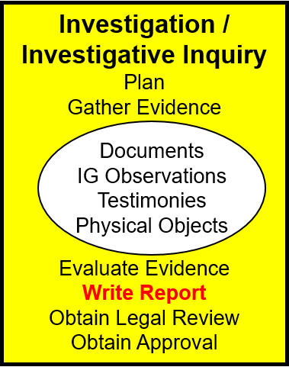
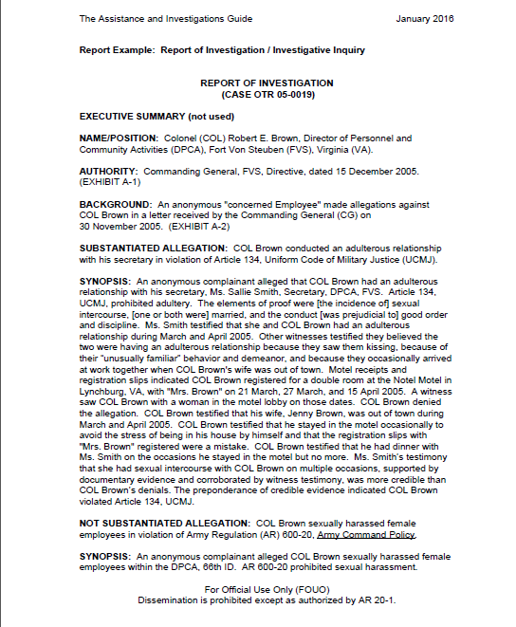
ALAMO Case Study
Step 4: Write Report
PE #14
Graded homework exercise
**Review Page II-D-2 / Digital Page 604
The A&I Guide, Part Two, Sections 4-13 (II-4-44), II-D-1 / Digital Page 323 and 603

Slide 124
Prepare to Write the ROI
ELO 13
Resolve Allegations of Impropriety using a Report of Investigation (ROI)
Review ALL of the evidence
Review ALL of the elements of proof
Complete and check your Evidence Matrix
Complete the Force-Field Diagram(s)
Organize your evidence into report exhibits
USE the A&I Guide – write the synopsis LAST!

Slide 125
ROI Tips
Allegations: Be clear, concise, and consistent
Standards: Use the correct one(s)
Evidence: Address elements of proof in standard(s)
Discussion: Explain the credibility of the evidence, AND discuss BOTH SIDES of the allegation (support and refute) thoroughly
Style:
  Past tense; “alleged” (NOT passive voice)
  Testified (under oath) vs. stated (not under oath)
  Header and Footer on all report pages: CUI
Example ROI in Section 4-13
The A&I Guide, Part Two, Sections 4-13 (II-4-44), II-D-1 / Digital Page 323 and 603

Slide 126
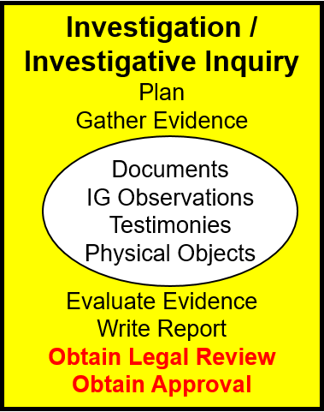
IG Fact Finding
Step 4
SJA reviews
Always for ROI
'S' for ROII
Hand-carry the report
CIG usually briefs results
Commander can:
  Approve
  Modify
  Direct additional action
  Disapprove
AR 20-1, Paragraph 7-1b(4); The A&I Guide, Part Two, Section 4-15 (II-4-151) / Digital Page 430

Slide 127
Notification of Results
Step 5
Step 5 Make Notification of Results
AR 20-1, paragraph 7-1b(5) The A&I Guide, Part Two, Chapter 5 (II-5-1) / Digital Page 434

Slide 128
Notification of Results
Step 5
The IG prepares all IG records for proper retention before notifications
Commander / Supervisor: [Format: A&I Guide page II-5-4]
  Notify in writing of the approved results
  Upload a copy of the notification in IGARS
Subject / Suspect: [Format: A&I Guide page II-5-3]
  Notify in writing of the approved results
  Upload a copy of the notification in IGARS
  Notify them of any unfavorable information included in the ROI / ROII and provide the opportunity to comment
  Substantiated allegation notifications must include FOIA request procedures / instructions
AR 20-1, Paragraph 7-1b(5) / Digital Page 64;
The A&I Guide, Part Two, Chapter 5 (II-5-2) / Digital Page 435

Slide 129
Follow-Up
Step 6
Step 6 Follow-Up
Ensure that all IG allegations and issues were thoroughly addressed, and IG responsibilities were completed.
The IG will attach to the electronic IGARS file all notifications and responses received from the subject or suspect relating to unfavorable information that appeared in the ROI / ROII.
The A&I Guide, Part Two, Chapter 6 (II-6-1) / Digital Page 440

Slide 130
Close the IGAR
Step 7
Step 7 Close the IGAR
Provide complainant a final reply in writing [Format: A&I Guide page II-7-3]
Close the file in the IGARS database
Make appropriate reports
Analyze developing trends
The A&I Guide, Part Two, Chapter 7 (II-7-1) / Digital Page 441

Slide 131
ELO Check on Learning
ELO 13. Complete a Report of Investigation (ROI).
  ROI utilization
  Interview order
  Required information to subject / suspect in substantiated finding

Slide 132


QUESTIONS?

